Slide 1
To-do App Creation Guide
12/10/2023
Creating a to-do app with javascript and bootstrap 5
JS Sessions – Full Stack Web Development

Slide 2
Agenda
JavaScript + BS5 To-do App Project
Questions
JavaScript Foundation
JS Sessions – Full Stack Web Development

Slide 3
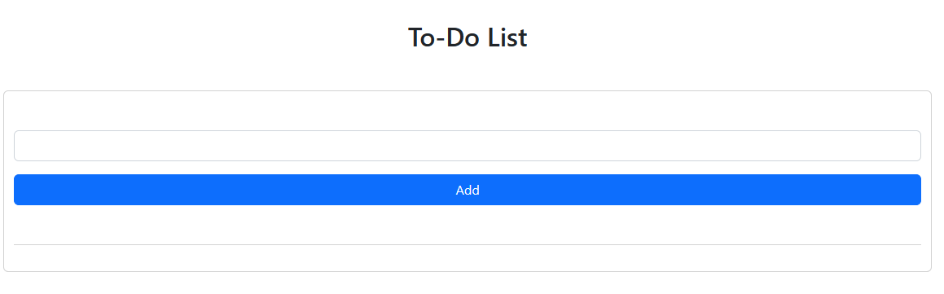
To-do App – querySelector
const inputBox = document.querySelector("#input-box");
const listContainer = document.querySelector("#list-container");
Two HTML elements are selected using document.querySelector and stored in variables:
#Input-box
#list-container
JS Sessions – Full Stack Web Development

Slide 4
To-do App – Question 1
What does the inputBox variable store in the JavaScript code?
a) A reference to a button element.
b) A reference to an input field with the id "input-box."
c) A reference to a container element with the id "list-container."
d) A reference to a list item element.
#Input-box
JS Sessions – Full Stack Web Development

Slide 5
To-do App – Question 1 - Answer
What does the inputBox variable store in the JavaScript code?
a) A reference to a button element.
b) A reference to an input field with the id "input-box."
c) A reference to a container element with the id "list-container."
d) A reference to a list item element.
#Input-box
JS Sessions – Full Stack Web Development

Slide 6
To-do App – Question 2
Which HTML element is selected using listContainer in the code?
a) A button element.
b) An input field with the id "input-box."
c) A list item element.
d) A container element with the id "list-container."
#list-container
JS Sessions – Full Stack Web Development

Slide 7
To-do App – Question 2 - Answer
Which HTML element is selected using listContainer in the code?
a) A button element.
b) An input field with the id "input-box."
c) A list item element.
d) A container element with the id "list-container."
#list-container
JS Sessions – Full Stack Web Development

Slide 8
To-do App – addTask function
Add a task to the task list/ #list-container
function addTask() {…}
JS Sessions – Full Stack Web Development

Slide 9
To-do App – Create html element
Creates a new list item (“li”) element using
document.createElement(“element”)
let li = document.createElement("li");
Sets the class name of the list item to "list-group-item" using
element.className
li.className = "list-group-item";
JS Sessions – Full Stack Web Development

Slide 10
To-do App – Question 3
How is the class name of the newly created list item set in the addTask function?
a) Using the innerHTML property.
b) Using the inputBox.value property.
c) Using the li.innerHTML property.
d) Using the li.className property.
JS Sessions – Full Stack Web Development

Slide 11
To-do App – Question 3 - Answer
How is the class name of the newly created list item set in the addTask function?
a) Using the innerHTML property.
b) Using the inputBox.value property.
c) Using the li.innerHTML property.
d) Using the li.className property.
JS Sessions – Full Stack Web Development

Slide 12
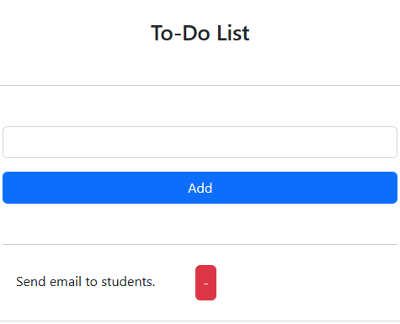
To-do App – Create html element
Sets the inner HTML of the list item to the value of inputBox:
element.innerHTML = element.value
li.innerHTML = inputBox.value;
Appends the newly created list item to the listContainer
element.appendChild(element)
listContainer.appendChild(li);
JS Sessions – Full Stack Web Development

Slide 13
To-do App – Create html element
let span = document.createElement("span");
span.className = "btn p-2 btn-danger ms-5";
span.innerHTML = "-";
li.appendChild(span);
Creates a "Remove" button with the span element:
Sets the inner HTML of the span to "-"
Appends the “-" button to the list item
JS Sessions – Full Stack Web Development

Slide 14
To-do App – Question 4
How does the "Remove" button get appended to a task (list item) in the addTask function?
a) It's created as a separate HTML element outside of the list item.
b) It's created as a child element of the list item.
c) It's created as a sibling element of the list item.
d) It's created using a different function.
JS Sessions – Full Stack Web Development

Slide 15
To-do App – Question 4 - answer
How does the "Remove" button get appended to a task (list item) in the addTask function?
a) It's created as a separate HTML element outside of the list item.
b) It's created as a child element of the list item.
c) It's created as a sibling element of the list item.
d) It's created using a different function.
JS Sessions – Full Stack Web Development

Slide 16
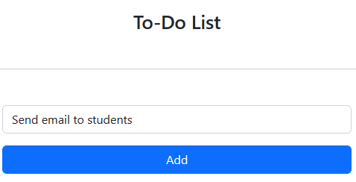
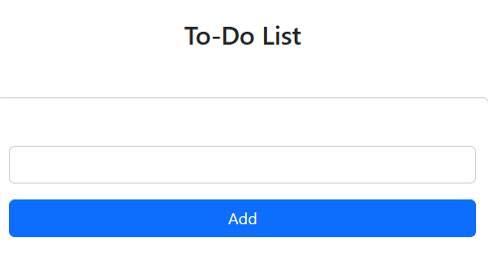
To-do App – Clear inputBox
inputBox.value = "";
clears the input field by setting its value to an empty string.
JS Sessions – Full Stack Web Development

Slide 17
To-do App – Question 5
What is the purpose of the inputBox.value = "" line in the addTask function?
a) It adds an empty list item to the task list.
b) It removes the last added task from the list.
c) It clears the input field after adding a task.
d) It sets the value of the input field to the task text.
JS Sessions – Full Stack Web Development

Slide 18
To-do App – Question 5 - Answer
What is the purpose of the inputBox.value = "" line in the addTask function?
a) It adds an empty list item to the task list.
b) It removes the last added task from the list.
c) It clears the input field after adding a task.
d) It sets the value of the input field to the task text.
JS Sessions – Full Stack Web Development

Slide 19
To-do App – Remove list item
An event listener is added to the to listen for click events.
listContainer.addEventListener(
"click",
function (e) {
if (e.target.tagName === "SPAN") {
e.target.parentElement.remove();
}
},
false);
When a click event occurs within the listContainer,
Checks if the clicked element's tag name is "SPAN."
If it is a “SPAN”,
it removes the clicked element's parent, which is a list item.
JS Sessions – Full Stack Web Development

Slide 20
To-do App – Question 6
Which event triggers the removal of a task in the code?
a) Mouseover
b) Click
c) Keydown
d) Double click
JS Sessions – Full Stack Web Development

Slide 21
To-do App – Question 6 - Answer
Which event triggers the removal of a task in the code?
a) Mouseover
b) Click
c) Keydown
d) Double click
JS Sessions – Full Stack Web Development

Slide 22
Your Questions

Slide 23
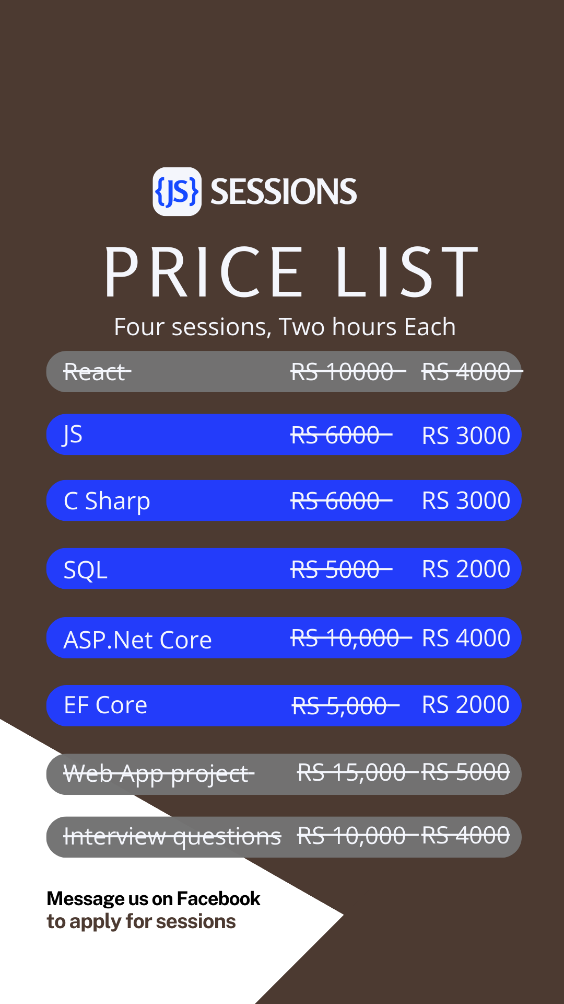

Next:
JS Sessions

